Slide 1

Movie Industry
-- Team 18
Jinghua Luo Wentian Lv
See more at https://jinghualuo-movie-app-movie-industry-vsl00y.streamlitapp.com/

Slide 2
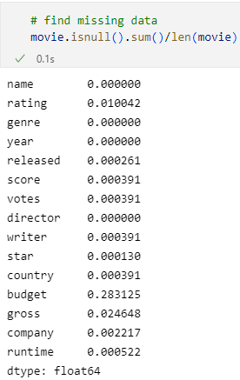
Dataset
use 3 different methods to deal with different situation
Basic information about dataset:
There are 7668 movies in the dataset (220 movies per year, 1980-2020).
There are 15 columns in the dataset. The columns we use for our app are:
-- name, genre, year, score, director, country, gross
Data Preprocessing -- Missing data:
Drop budget column: 28% of budget is missing
Delete these rows: released, score, votes, writer, star, country, company, runtime with missing data (less than 1%)
Fill the missing values:
-- rating: strings data, use the most frequent value to fill
-- gross: numerical data, use mean to fill.

Slide 3
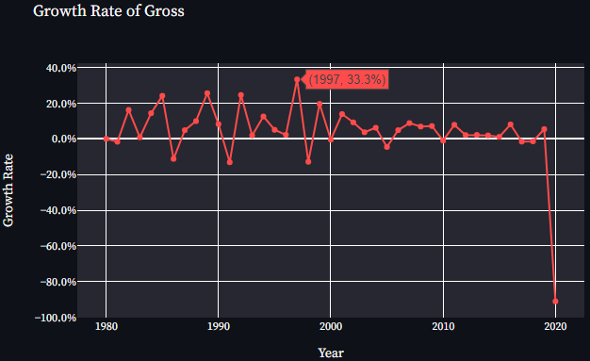
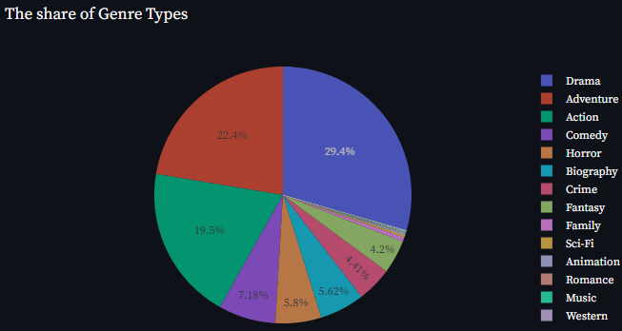
Basic Question & Analysis
What is the development of global movie industry in 1980-2020 ?
use 4 plots to analzye this question.
The first is growth rate of gross...
The growth rate of gross fluctuated at about 5%. It peaked at 33.3% in 1997, and reached the bottom at -91.0% in 2020 because of the COVID-19.
There are 19 genres of movies. Drama, adventure and action made up the largest proportion.

Slide 4
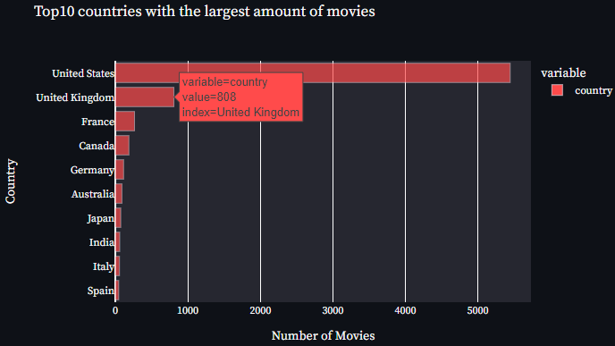

Basic Question & Analysis
What is the development of global movie industry in 1980-2020 ?
In terms of the amounts of movies, U.S and United Kingdom dominated the movie industry.
The wordcloud shows some famous director who made large amounts of movies, such as Woody Allen, Steven Spielberg.

Slide 5
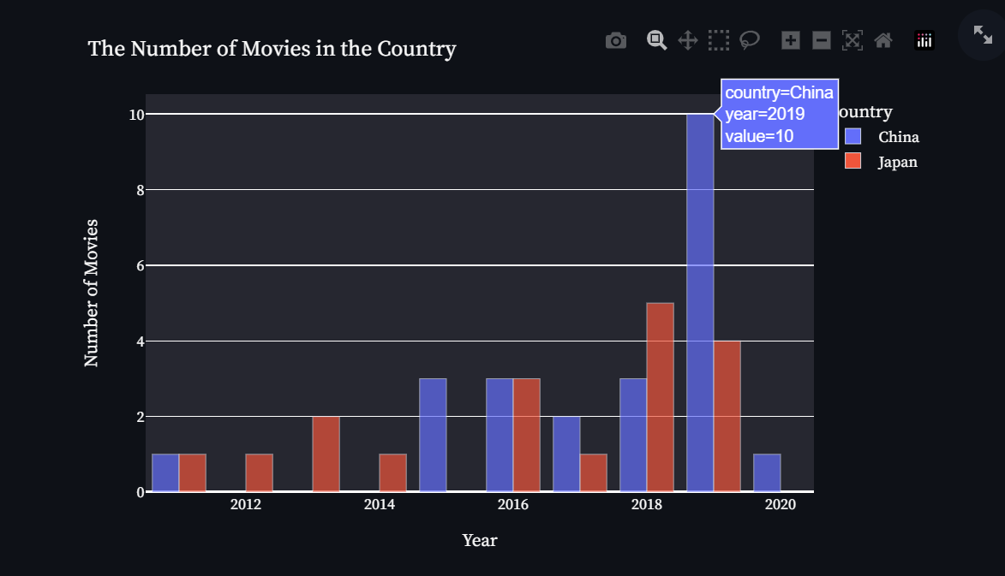
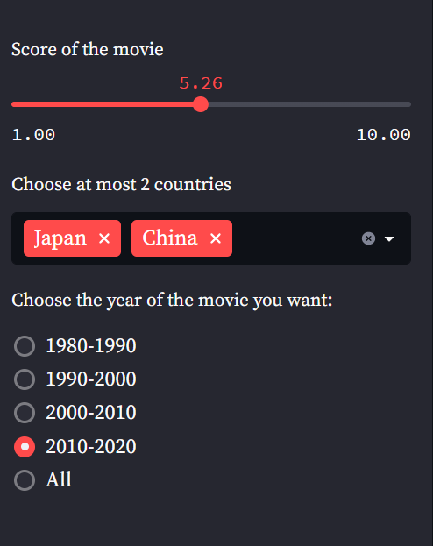
Basic Question & Analysis
What is the development of movies in terms of the specific country？
Set up 3 interactive widgets:
Score slider
Multi-select of country
Single-select of one decade
Show the interactive barplot:
In the specific decade, the amounts of movies that is larger than the certain score of the country.
To make a comparison about the number of movies between two countries.

